Slide 1
Information Technology Fundamentals
DT211C/1
Tutorial 4 - IT New Systems
Thursday 13 October 2016

Slide 2
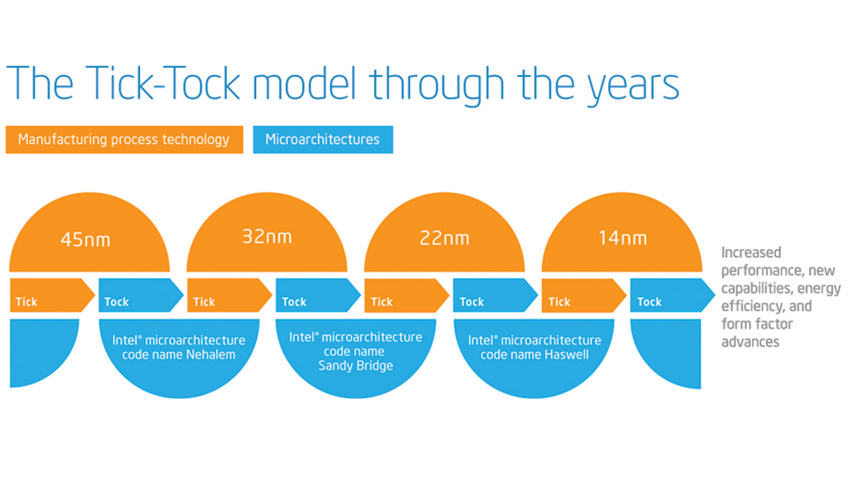
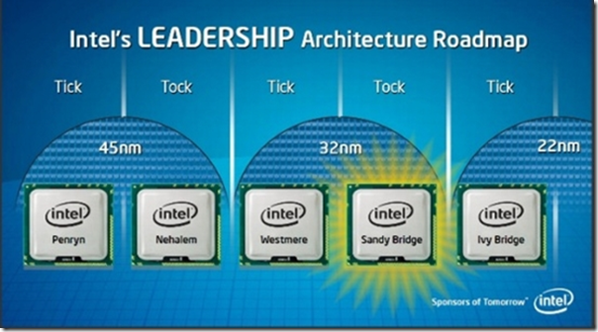
‘Tick, Tock’?
What is the Intel company’s idea of:
‘Tick Tock, Tick Tock’?
How about ‘Tick, Tock, Tock’?

Slide 3
Web Links for ‘New Systems’
Here are some links that I used for the ‘New Systems’ lecture that you might find useful to see what the latest is, for hardware, software and infrastructure:
http://www.cnet.com/au/news/
http://www.wired.com/gear/
http://wccftech.com/intel-skylake-processors-integrate-iris-gt4e-level-graphics-chip-features-72-execution-units-128-mb-edram-llc/
http://www.intel.com/content/www/us/en/silicon-innovations/intel-14nm-technology.html

